Slide 1

Code.Jam(2020)
Petar Basta
Olga Jankovic

Slide 2




Problem: Social isolation is increasing due to COVID 19 restrictions, making it difficult to meet new people outside your circle
AnyChat. Chat with anyone, anytime, about anything. Bringing people together while physically apart.
`
Anyone Safely and anonymously connect with people to discuss topics of mutual interest | Anytime AnyChat is accessible worldwide and available to use around the clock. | Anything Chat about any topic varying from World Politics to amusing cat videos.

Slide 3


Problem: Social isolation is increasing due to COVID 19 restrictions, making it difficult to meet new people,
`
Our Inspiration Our inspiration for this website was a combination of our own experiences with meeting strangers and the longing for a more fast-paced alternative to forums. | How is it different? In the way that it is live and the way its mimics real-life conversations with others. There is much less waiting than in forums/comment sections.

Slide 4




`
Amanda Wants to talk about new Spiderman movie She starts a chat and waits to see other opinions | Steve Wants to talk about US Elections Finds the Spiderman chat and agrees | Annie Wants give/receive some good book recommendations Finds spiderman chat and disagrees

Slide 5
Future Additions
Filters
For hate speech
For malicious content
For misleading statements or information
Log in measures
Voice call features
Saving chats in a database

Slide 6

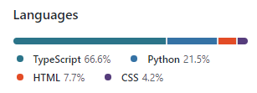



Tools and Technology

Slide 7
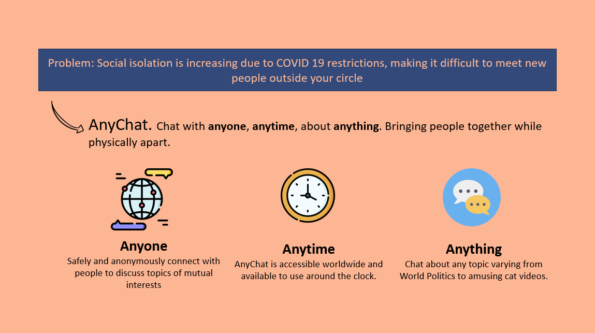

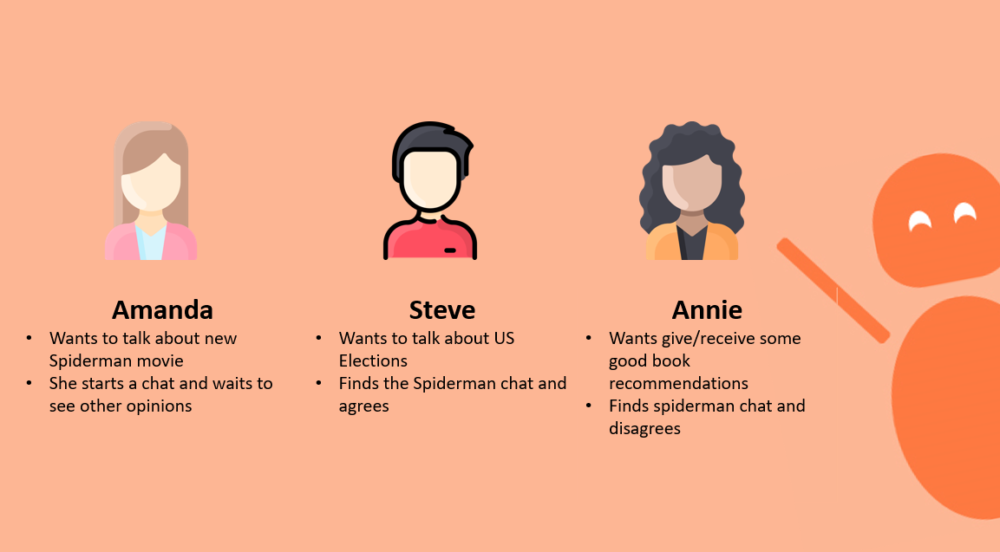
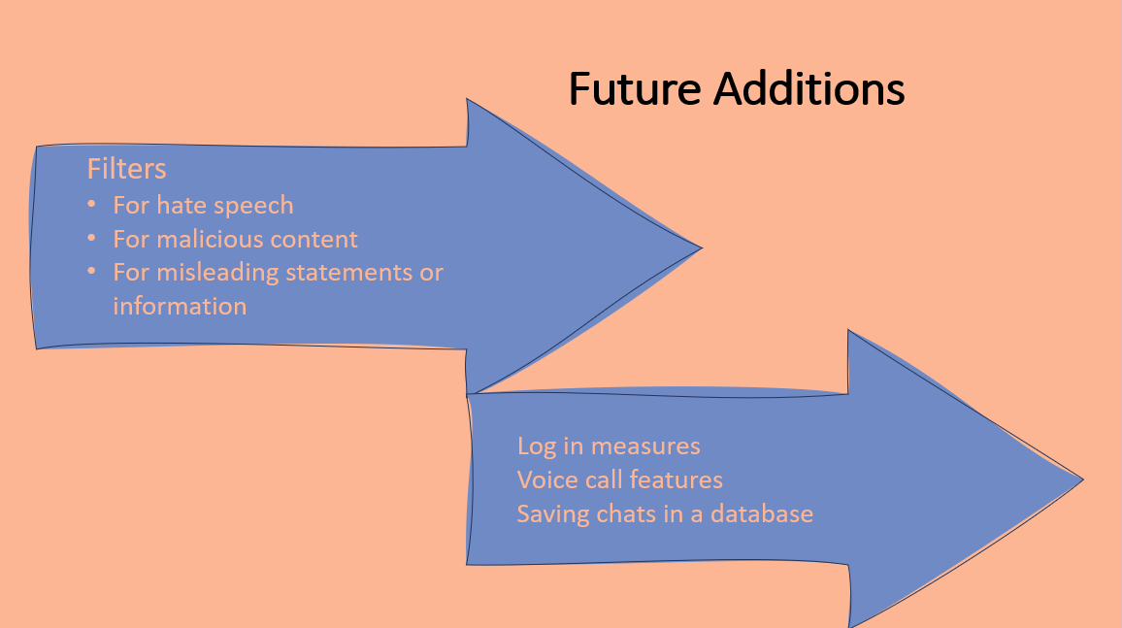
Thank you

